Slide 1



Slide 2
Course details
LTP – 300 [three Lectures /week]
Course communication mode: lpulive, UMS, myclass
Google docs Link: https://drive.google.com/drive/folders/1fBDeZgiYv5ZN2Ds MF3V7_3Ulj062ttEQ?usp=sharing
Text Book
Beginning RedHat Linux by Sandip Bhattacharaya,Wiley c
Publication,1st edition.

Slide 3
Course Assessment Model
Marks break up*
Attendance | 5
CA (Best 2 out of 3) | 25
MTE | 20
ETE | 50
Total | 100

Slide 4

The hitch…
The three BURNING questions in mind…
Why are we learning LINUX?
What would we do with it?
What will be the course outcome?

Slide 5

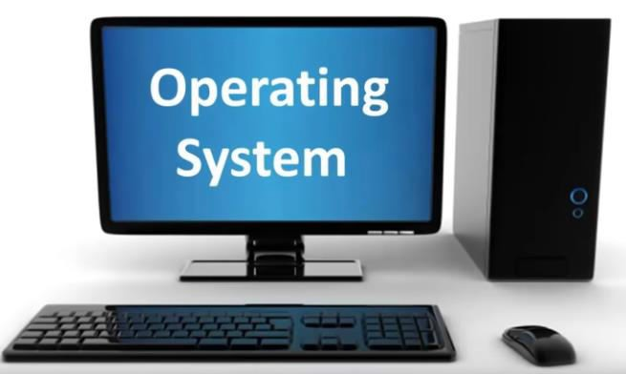



Slide 6
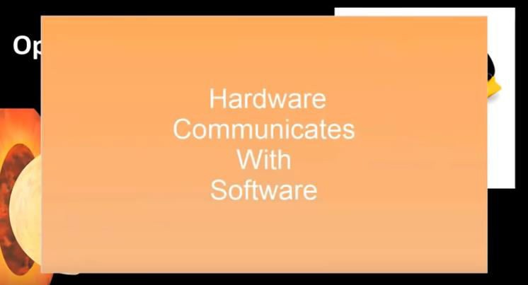

Slide 7
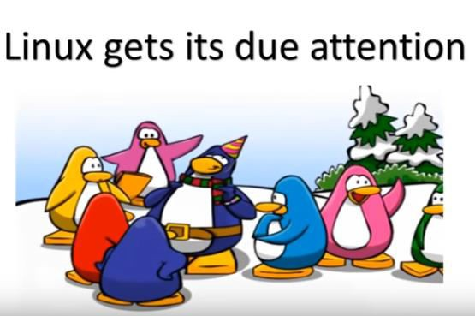
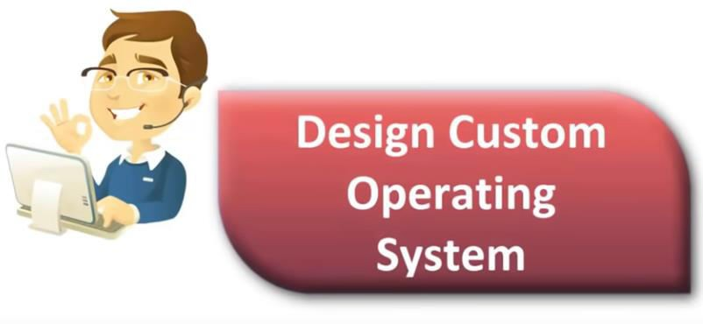
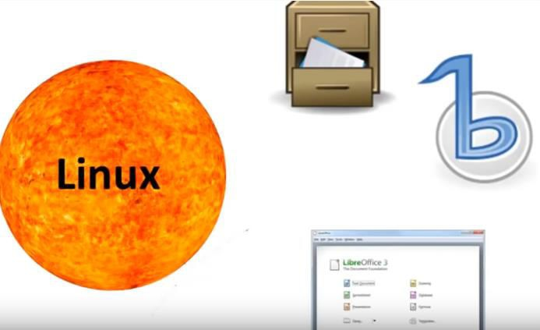
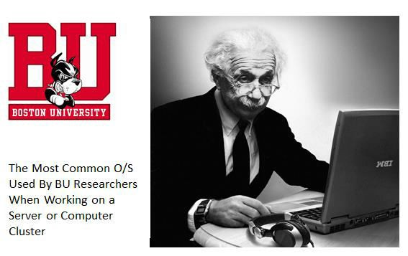

Slide 8
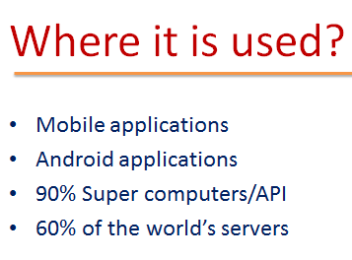

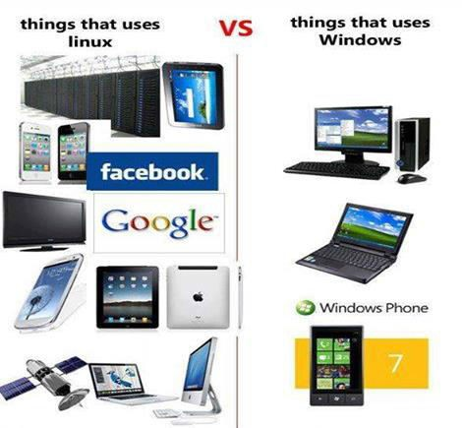


Slide 9


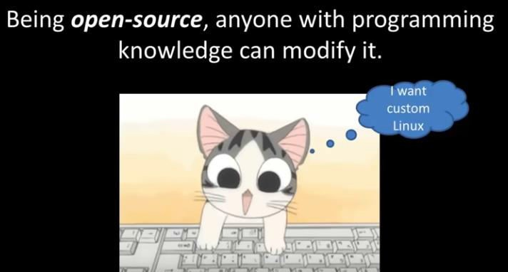
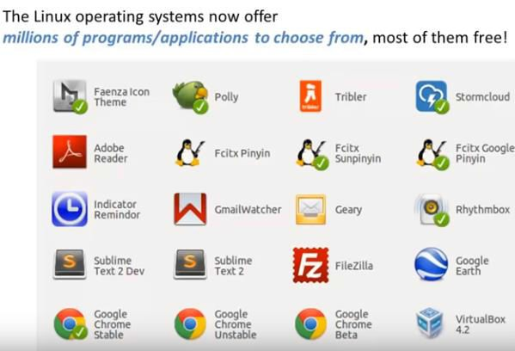
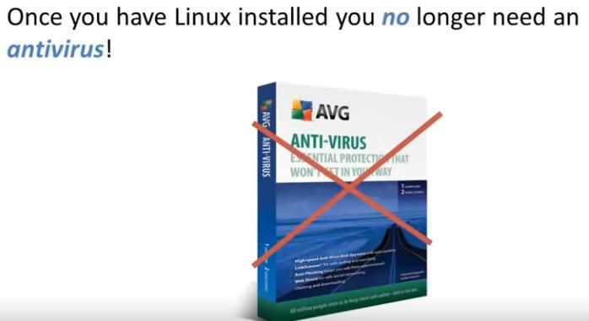
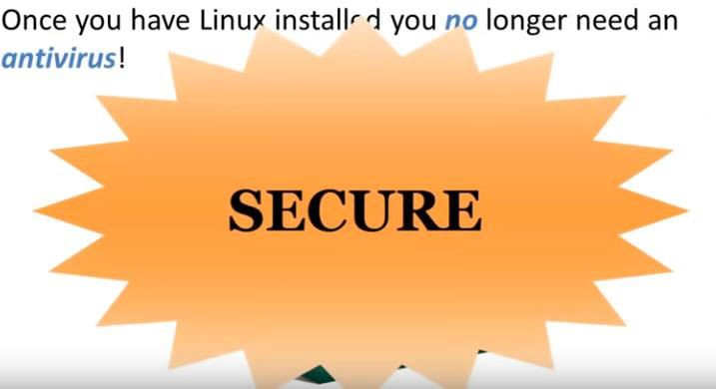
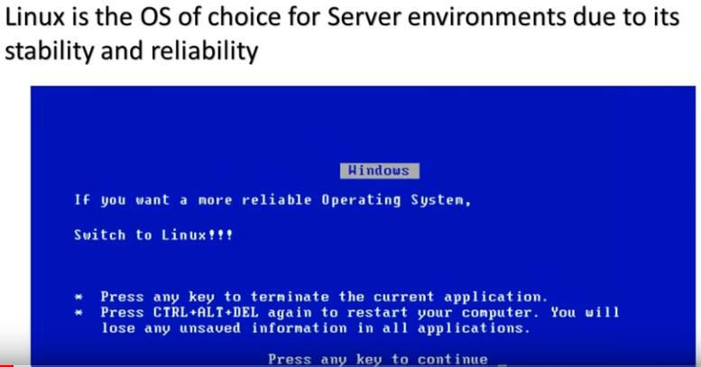

Slide 10



Slide 11


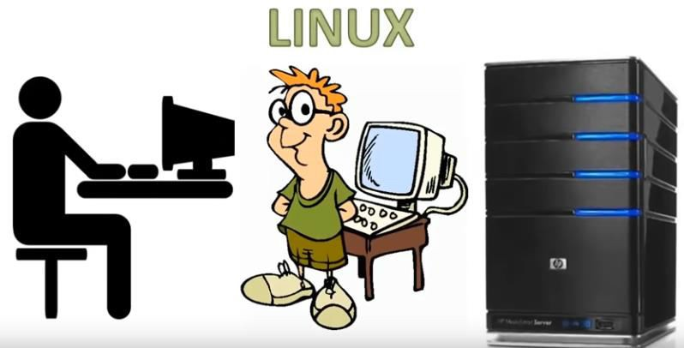

Slide 12
The course content
Introduction to OS
Installation process
Disk partitioning
Creation of groups and user accounts
Desktop handling
Software installation
Different types of server handling
Authentication to users and files.

Slide 13
Course Outcome…
By the end of the this semester every one of you would:
understand Linux environment and basic Linux administration tasks
develop comprehensive introduction to shell scripting and programming in Linux
interpret how to administer a Linux machine and configure different Linux servers like
samba, ftp, apache and nfs
examine the configuration process to create a properly functioning Linux environment.
analyze the need for security measures for a Linux environment

Slide 14
See You In The Next Class

